Slide 1
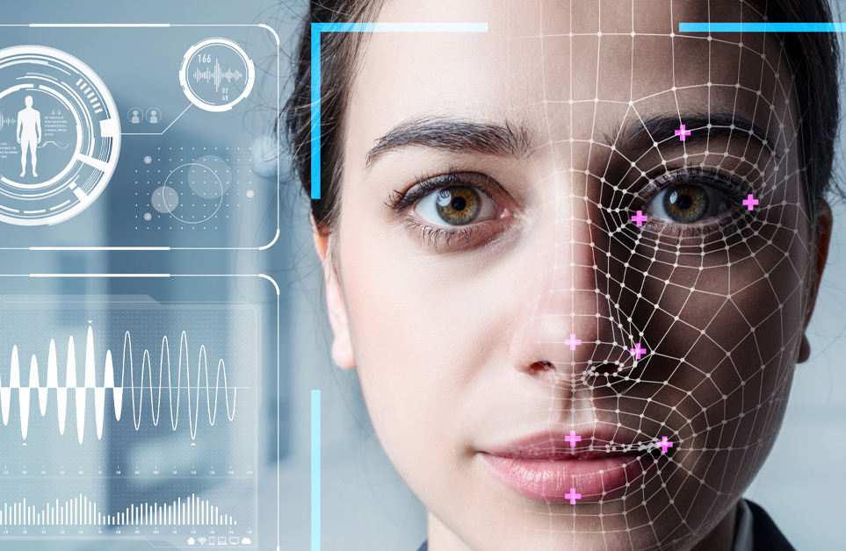
Facial Attribute Recognition using Deep Learning
Lee & Sike
This Photo by Unknown author is licensed under CC BY-ND.

Slide 2

Introduction
Facial Attribute Recognition: An important problem in machine intelligence with applications in human-computer interaction, security, and research.
Project Goal: Build and train neural networks on the CelebA dataset to perform facial attribute recognition.
Methods:
Convolutional Neural Network (CNN): Built from scratch, trained, and tuned.
Transfer Learning: Leveraged Chollet’s Xception model pre-trained on ImageNet.
Objective: Gain hands-on experience and achieve a strong understanding of deep learning techniques.
Project Definition

Slide 3

Dataset
Source: Collected by the Multimedia Laboratory at the Chinese University of Hong Kong.
Popularity: Featured in over 2,000 research papers in the last five years.
Details: Contains 202,599 images labeled for 40 facial attributes (positive or negative).
Class Imbalance: More images labeled as negative for most attributes; critical for evaluation.

Slide 4

Methodology
Preprocessing
Data Loading: Images converted to TFRecords for efficiency.
Exploratory Data Analysis: Visualized images, checked for null labels, analyzed class distribution.
Dataset Split: 80-10-10 split for training, validation, and testing as per dataset authors' recommendations.

Slide 5
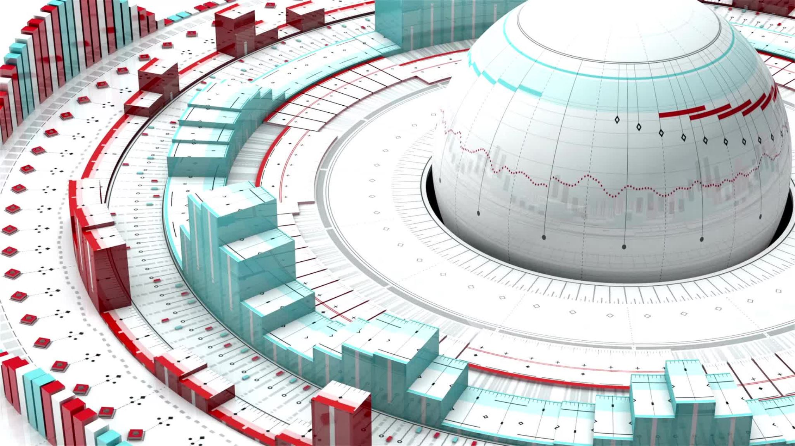
Methodology
Convolutional Neural Network
Architecture: 1,711,624 parameters; 10 conv2D layers, 5 maxpool2D layers, 3 dense layers.
Training: 40,000 training, 10,000 validation, 10,000 test images normalized to 0:1 range.
Early Stopping: Configured with min_delta 0.01 and patience of 5, trained for 40 epochs.

Slide 6
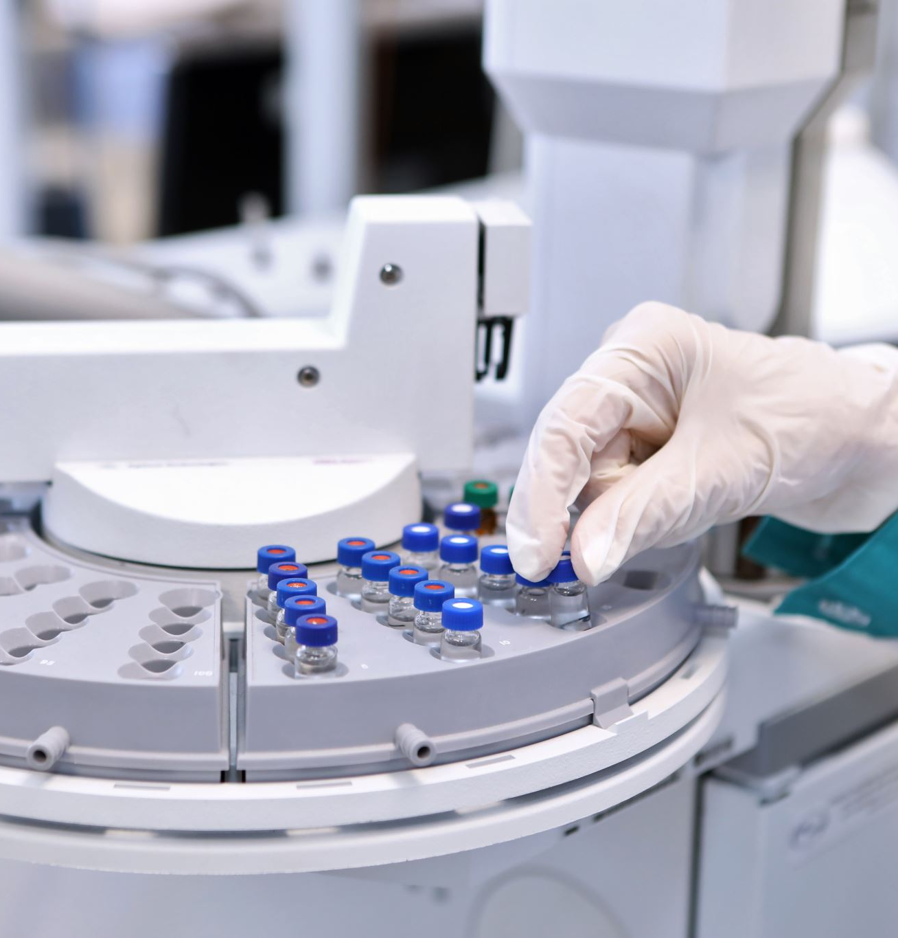
Methodology
Transfer Learning
Base Model: Xception model pre-trained on ImageNet.
Adaptation: Removed top layer, froze weights, input shape set to (150, 150, 3).
New Top Layer: Global average pooling, dropout for regularization, dense layer with 40 outputs (sigmoid activation).
Training: Initial 20 epochs, followed by fine-tuning with low learning rate.

Slide 7

Evaluation Metrics
Classic Metrics: Hamming loss, Hamming score, recall, precision, F1 measure.
Custom Metrics:
CustomAccuracy: Tracks accuracy considering true positives/negatives, false positives/negatives.
MultiLabelAccuracy: Computes Jaccard index (IoU) for overlap between predicted and actual labels.
Threshold Optimization: Different thresholds explored for each label to maximize F1 score.

Slide 8

Results
Hamming Loss: 0.11176, indicating 11.18% incorrect labels per instance.
Recall: 0.80475, showing strong capability to capture relevant labels.
Precision: 0.67229, suggesting 67.23% correct positive predictions.
F1 Measure: 0.71656, balancing precision and recall.
Hamming Score: 0.57828, indicating effective overlap with true labels.
Interpretation:
Strengths: High recall and balanced F1 score.
Areas for Improvement: Precision indicates potential overfitting to certain labels.
Future Work: Focus on reducing false positives, better data preprocessing, enhanced feature engineering, and experimenting with different thresholds.
Results Discussion

Slide 9

Thank you!
References
Large-scale CelebFaces Attributes (CelebA) Dataset | The Chinese University of Hong-Kong
CelebA Dataset Usage | Papers With Code
Transfer learning and Fine-tuning | Keras
Xception: Deep Learning with Depthwise Separable Convolutions | Francois Chollet
Evaluating Multi-label Classifiers | Towards Data Science | Aniruddha Karajgi
Metrics for Multilabel Classification | Mustafa Murat ARAT

